Slide 1


Administración de Sistemas y Seguridad
Máster en Ingeniería Informática
Security in cloud environements
Saidani Khaled Mohamed Elamine
Hamada Bouhacida
Granada 2021

Slide 2
INDEX
01. Introduction to cloud environments
02. History and evolution
03. Why do they need security?
04. Security flaws
05. Examples of famous cloud attacks
06. Security tools

Slide 3

The emergence of this term goes back to the sixties of the last century, when some companies began to think about the extent of the benefit that would be achieved by making computing a service and a utility tool provided to individuals over the Internet, and this term refers to the possibility of companies and individuals obtaining some services such as storage, databases, software and other various services Through the internet.
01.Introduction
Advantages of Cloud Computing There are many benefits that can be obtained from using cloud computing services over the Internet, and the most prominent of these benefits and advantages are the following:
1-Reducing cost.
2-the speed.
3-Security.
4-Accessed through the network
5-Free from customer maintenance.
6-Flexible scalability.

Slide 4
02. History and evolution
Definition of CC
By Prof.Ramnath Chellappa
Amazon
launching Elastic Compute
ARPANET
By J.C.R.Licklider
1960
1970
2000
1969
1997
2008
JohnMcCarthy
Introduces mainframe timesharing
Virtualization
Software launched
Emergence of first solutions

Slide 5
03.Why do we need Security ?
- Increase in security breaches over time.
- Cyber attacks.
- Possible data loss.
-The increasing transfer of data and applications to the cloud.
-Leaks and stolen data.

Slide 6
3.1.Security requirements Data:
Internet
- Access control.
- Viewing information according to privileges.
- Monitoring and recording of operations.
- Redundancy and backups.
- Encryption.
- Blocking access to files.
- Malicious code injections.
Internet Service Providers
Governments
Hackers & Snoopers

Slide 7
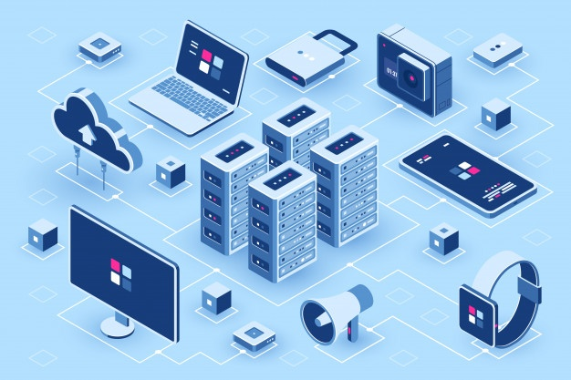
3.2.Security requirements Servers:
Necessary dependencies.
Minimum privilege.
Strong passwords.
Double factor authentication.
Intrusion detection, attacks and monitoring.
Intrusion and configuration tests.
Isolated MVs.
Access control, monitoring and audits of resources
!

Slide 8

3.3.Security requirements Networks:
- Segmentation.
- End-to-end encryption.
- Monitoring, detection and action against DDos
attacks.
- Necessary access points.
- Restrict Internet access.
- Standard and secure communication protocols:
VPN, TLS, HTTPS.

Slide 9
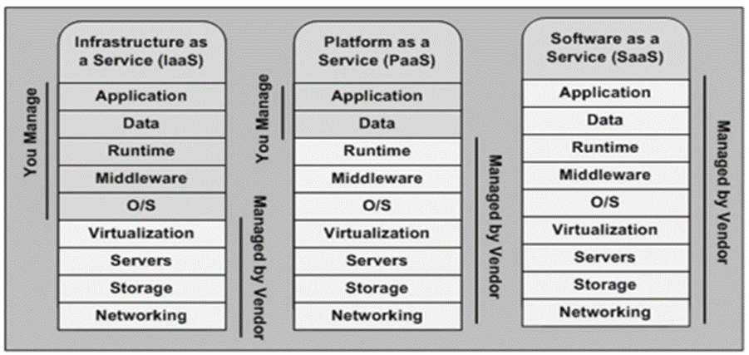
04.Security flaws
- Access to the machine vs. Access to services and data.
- Zero Trust Architecture.
-Attackers:
-Brute force.
-Account hacking.
-Phishing.
-Social engineering.
-DDoS
-Malware injection.

Slide 10






05. Examples of attacks
Dropbox
Tesla
OneDrive
Dyn

Slide 11


06.Security tools

Slide 12
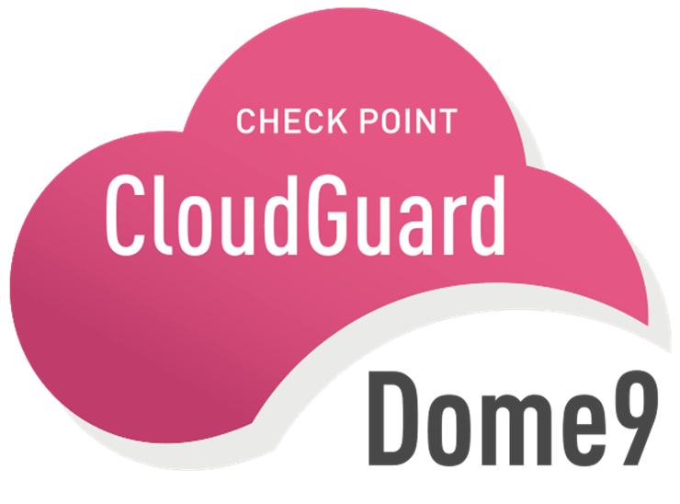
CloudGuard Dome9
- Configuration, good practices in legislation and security.
- Protection against theft of credentials and data.
- Contextual intelligence.
- Threat information.
- Improved detection.
- Payment tool.
- AWS, Azure and Google Cloud

Slide 13

Panther
- Open source.
- AWS CloudFormation.
- Threat detection with deterministic rules.
- Log analysis to detect unauthorized access and suspicious behavior.
- Automatic correction of vulnerabilities in the configuration.

Slide 14

ZeeK
- Open source.
- Intrusion detection and prevention.
- Network monitoring.
- Adaptation to the context of the network.
- Customize their behavior through scripts.
- Forensic services.

Slide 15

okta
- Payment tool.
- Network protection.
- Monitoring and control of user and employee access.
- Multi-device.
- Management of particular privileges and authentication.
- Configurable login.

Slide 16
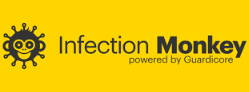
Infection Monkey

Slide 17
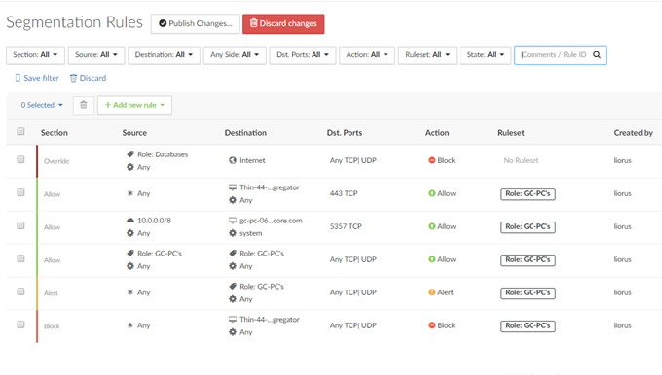
Infection Monkey
- Open source.
- Analyze public and private cloud systems and network configuration.
Source: Guardicore Centra Security Platform.
Hybrid environments, VMs, containers, etc.
Contextualize the data to generate a representative map of the network.

Slide 18
Characteristics and limitations
-Multi platform.
-Programmed in Python.
-Single or joint systems.
-Real attacks, they are not simulations.
-It does not affect performance.
-Reports with different levels of detail.
-It proposes solutions to the incidents found.
-Cyber-collection: injection of malware to filter sensitive information (espionage).
-Data leakage.

Slide 19
Available exploits and attacks
- Credential analysis.
Caches to obtain the key or its hash.
Passwords similar to domain and username.
Mimikatz Framework.
Network segmentation.
It infects systems on a subnet.
Spread the infection to the rest of the segments.
Tunneling.
Verify the origin of the requests.
Serve malicious machines.
Sambacry.
Shellshock.
ElasticGroovy.
Struts2.
Weblogic.
Theft of credentials.
Hadoop.
Brute force intrusion.
SSH.
SMB (Server Message Block).
WMI (Windows Management Instrumentation).

Slide 20
Conclusion
- Security is an indispensable feature in the cloud.
- Cloud providers are responsible for implementing the necessary security measures in the systems, while users are responsible for their applications and data.
- Availability of various analysis and protection tools and As the cloud evolves, security policies must be updated.

Slide 21
THANK YOU

